Slide 1
Lecture 06 – Deep Learning and CNNs
Prof. André Gustavo Hochuli
gustavo.hochuli@pucpr.br
aghochuli@ppgia.pucpr.br
Notes:
Prof. André Hochuli

Slide 2
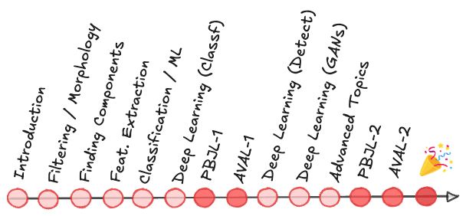
Topics
Traditional vs Deep Learning Neural Network
Feature Engineering, The Curse of Dimensionality
Multi-Layer Perceptron & Kernel-Based Descriptors
Deep Learning
Introduction to Convolutional Neural Networks
Coding
Computer Vision - Prof. André Hochuli
Lecture 06
Notes:
Prof. André Hochuli

Slide 3
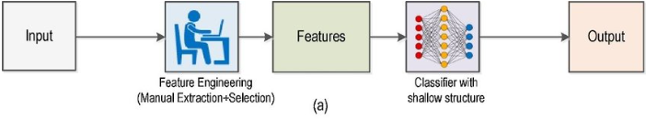
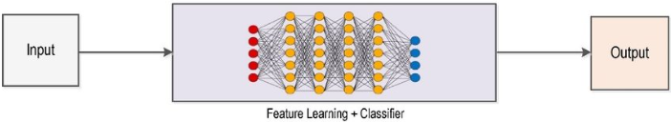
Traditional and Deep Learning
Traditional (“Shallow”)
Deep
Computer Vision - Prof. André Hochuli
Lecture 06
Notes:
Prof. André Hochuli

Slide 4
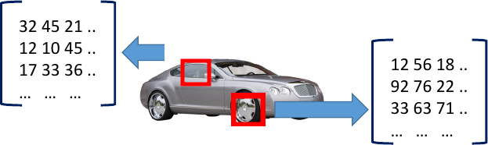
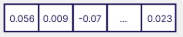
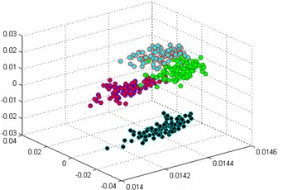
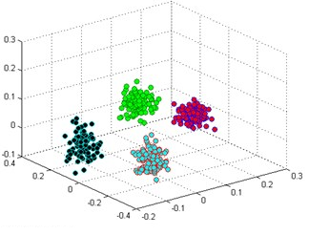
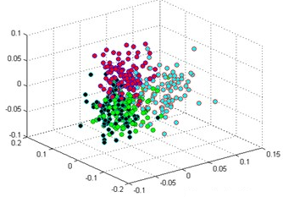
“Shallow” Learning
How to effectively capture discriminative features from images?
Computer Vision - Prof. André Hochuli
Lecture 06

Slide 5
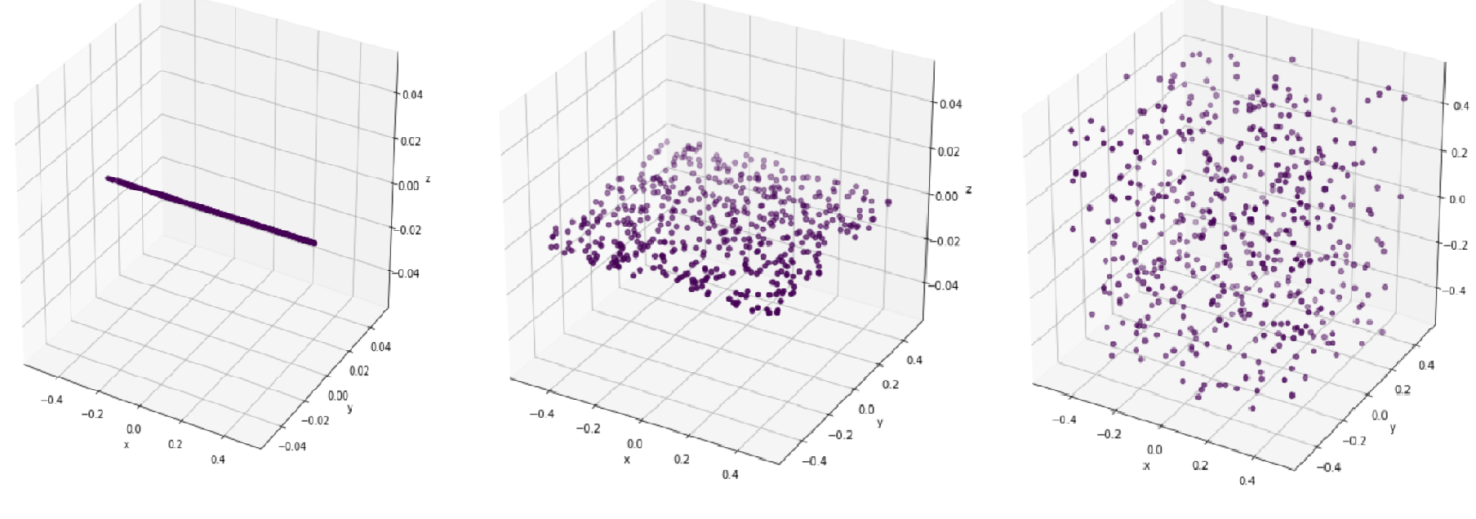
The Curse of Dimensionality
Most of us have very reasonable intuition that more information in terms of features (dimensions) is always better. Is this always true?
Exponential Growth of Feature Space → sparsity increases
Distance Metrics Lose Meaning → similarity becomes unreliable
More Data Needed → exponential increase in samples
Risk of Overfitting → noise dominates patterns
Mitigation → feature selection, PCA, autoencoders
Computer Vision - Prof. André Hochuli
Lecture 06

Slide 6
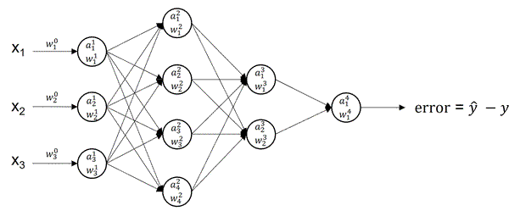
Multi-Layer Perceptron: Recap
Features
Weights
Feedforward
Error Backpropagation
Computer Vision - Prof. André Hochuli
Lecture 06

Slide 7
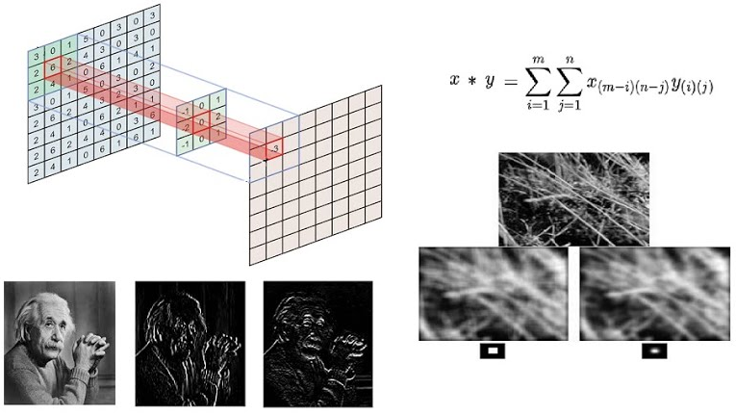
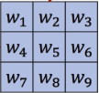
Kernel-based Descriptors: Recap
Computer Vision - Prof. André Hochuli
Lecture 06

Slide 8
Kernel-based Descriptors: Recap
Why not extend weight optimization to learning kernels (features)?
Computer Vision - Prof. André Hochuli
Lecture 06

Slide 9
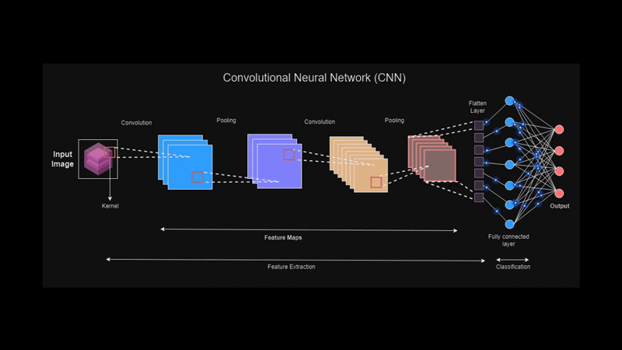
Deep Learning
Why not extend weight optimization to learning kernels (features)?
Computer Vision - Prof. André Hochuli
Lecture 06
Notes:
Prof. André Hochuli

Slide 10
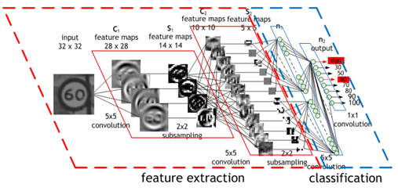
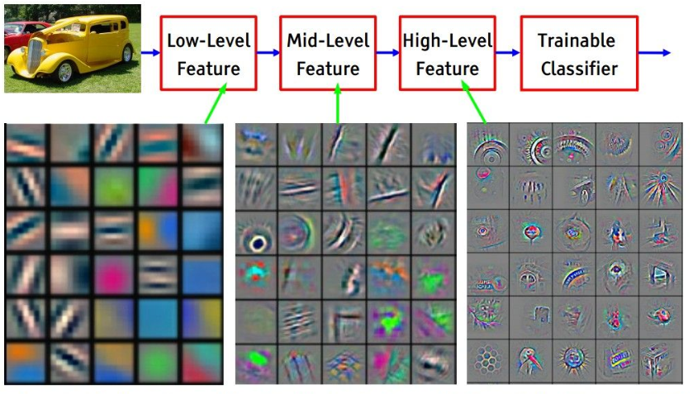
Convolutional Neural Networks
Feature Extraction
Sequential Convolutional Layers
Learnable Descriptors (Kernels)
Activation Functions (ReLU)
Pooling Layers
Classification
Fully-Connected Layers
SVM
….
Computer Vision - Prof. André Hochuli
Lecture 06
Notes:
Prof. André Hochuli

Slide 11
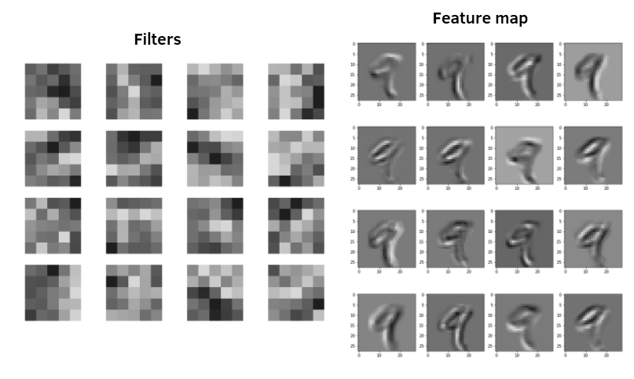

Convolutional Neural Networks
Learned Filters (Kernels) and The Resulting Feature Map
Computer Vision - Prof. André Hochuli
Lecture 06
Notes:
Prof. André Hochuli

Slide 12
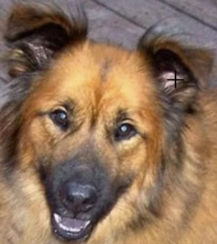
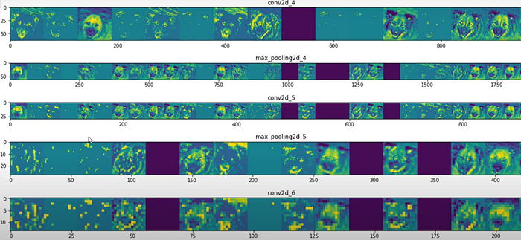
Convolutional Neural Networks
Feature Maps
Computer Vision - Prof. André Hochuli
Lecture 06
Notes:
Prof. André Hochuli

Slide 13
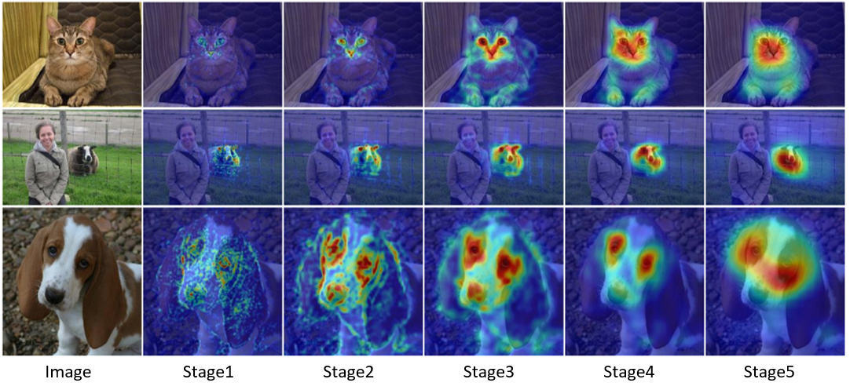
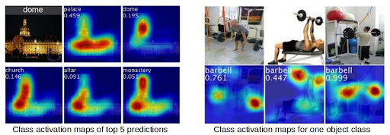
Convolutional Neural Networks
Activations Maps
Computer Vision - Prof. André Hochuli
Lecture 06
Notes:
Prof. André Hochuli

Slide 14
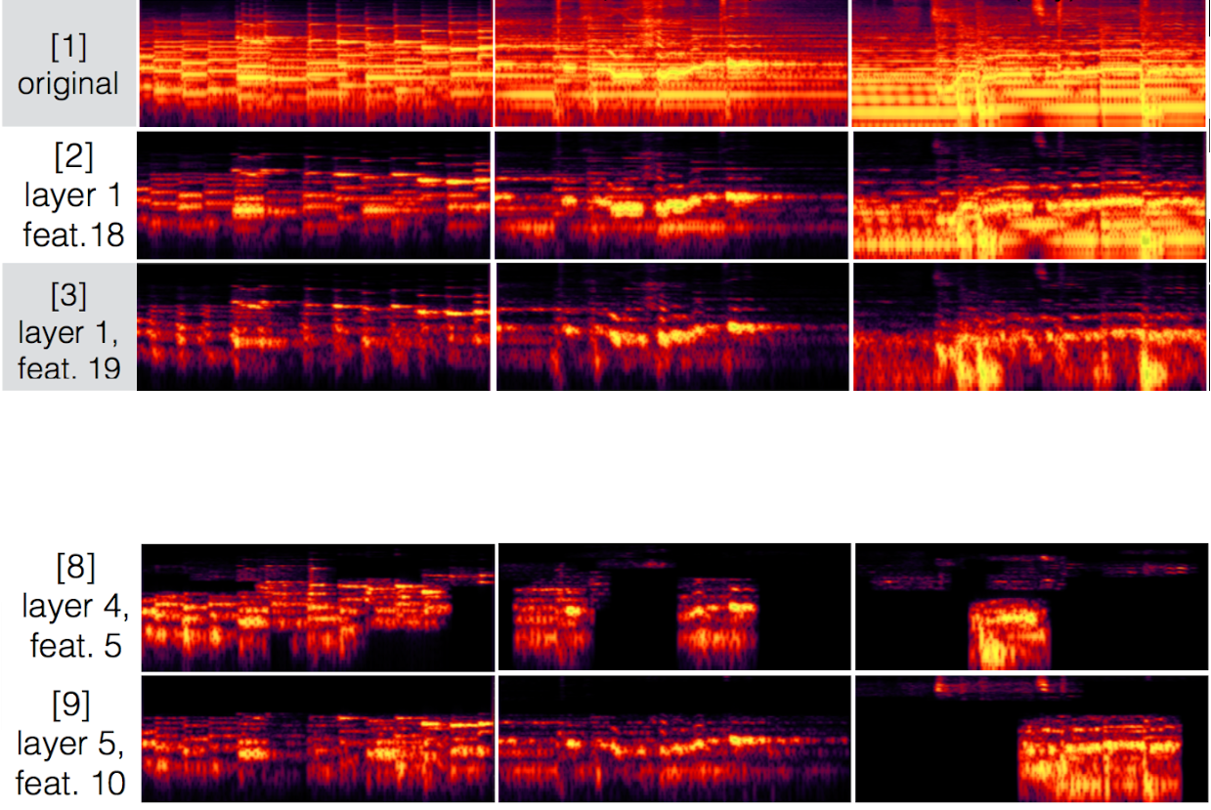
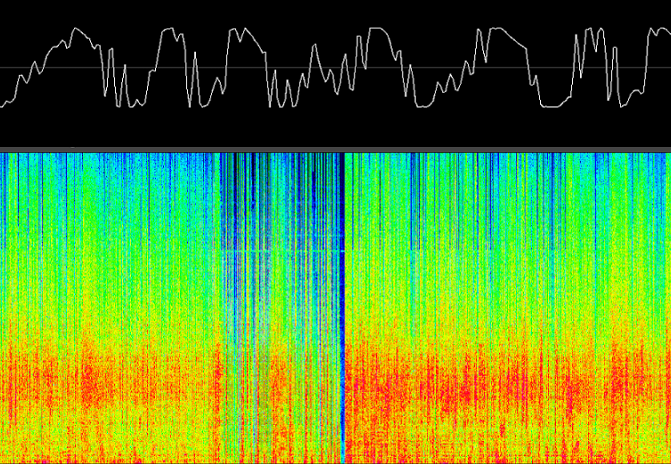
Convolutional Neural Networks
Wide applied in the Computer Vision area (audio, images, video processing, etc.).
Piano
Piano+Vocal
Piano + Vocal
+ Bateria
Computer Vision - Prof. André Hochuli
Lecture 06
Notes:
Prof. André Hochuli

Slide 15
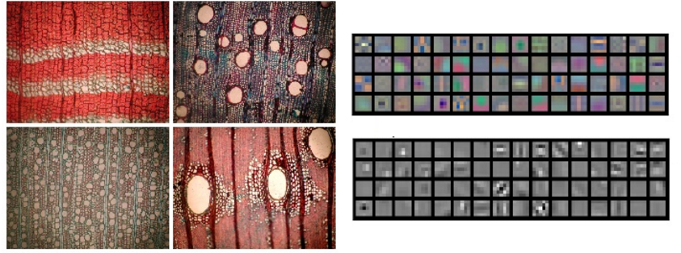
Convolutional Neural Networks
Tissue Classification
Medical Images
Computer Vision - Prof. André Hochuli
Lecture 06
Notes:
Prof. André Hochuli

Slide 16
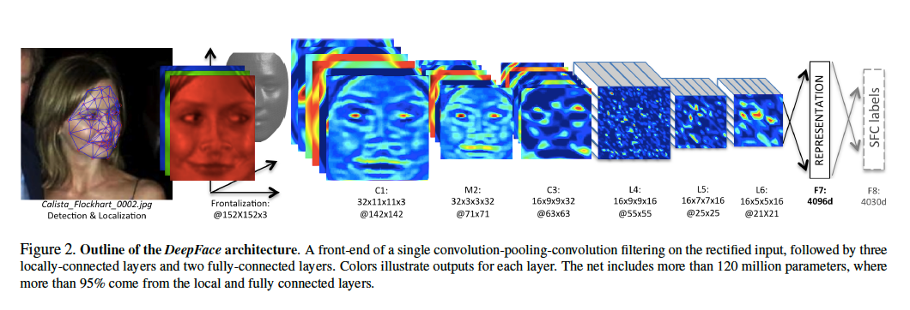
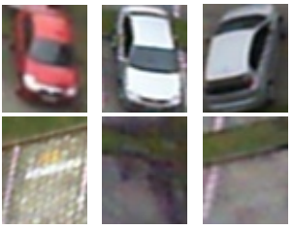
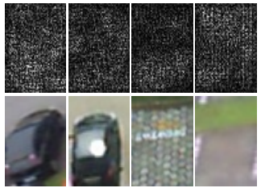
Convolutional Neural Networks
Face
PKLot
Computer Vision - Prof. André Hochuli
Lecture 06
Notes:
Prof. André Hochuli

Slide 17
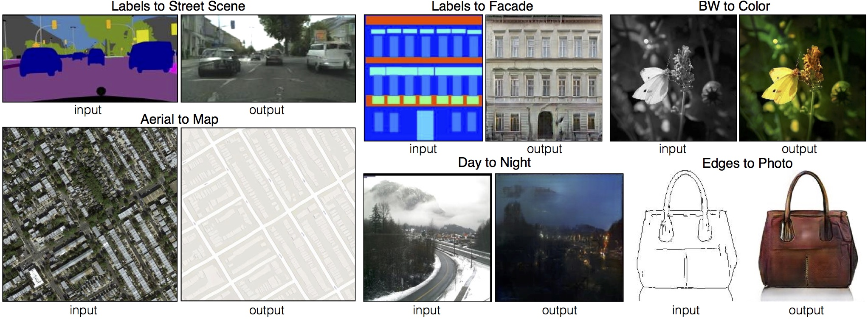
Convolutional Neural Networks
Image Translation
Computer Vision - Prof. André Hochuli
Lecture 06
Notes:
Prof. André Hochuli

Slide 18
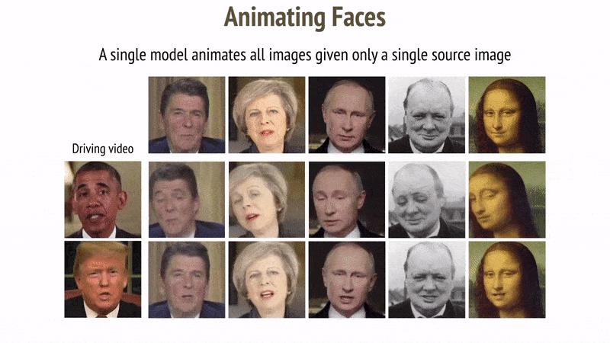
Convolutional Neural Networks
Deep Fakes
https://www.youtube.com/watch?v=mUfJOQKdtAk
Computer Vision - Prof. André Hochuli
Lecture 06
Notes:
Prof. André Hochuli

Slide 19
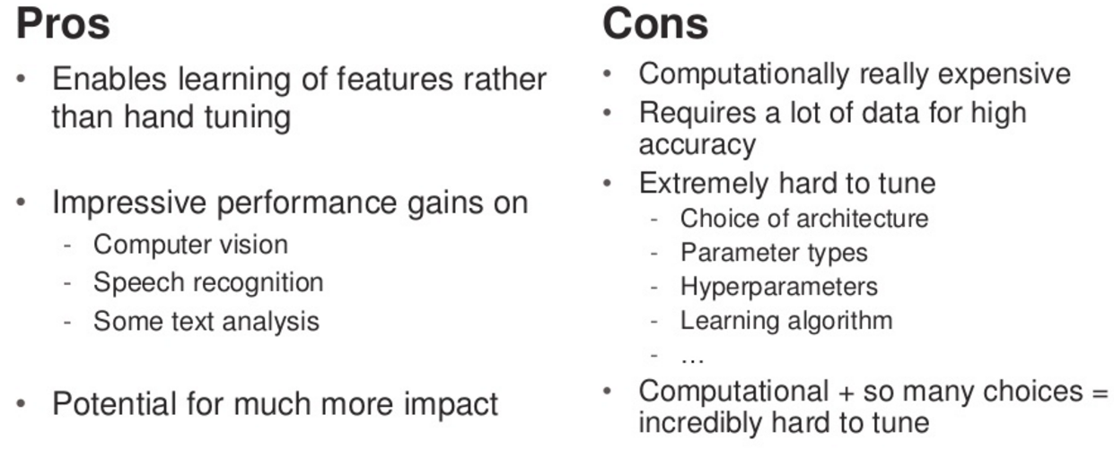
Convolutional Neural Networks
Computer Vision - Prof. André Hochuli
Lecture 06
Notes:
Prof. André Hochuli

Slide 20
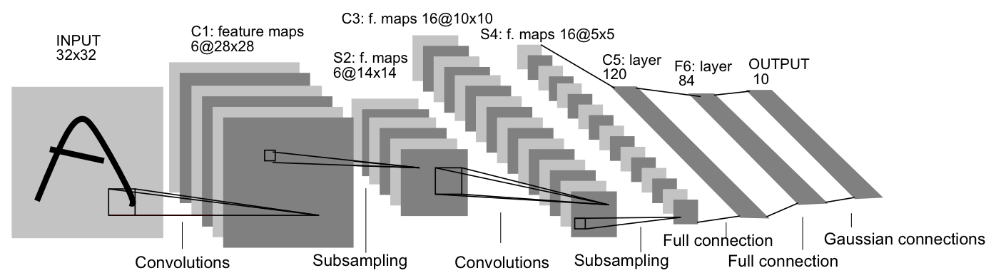
Convolutional Neural Networks
Lenet
Yan Lecun – 90´s (Bell Labs / IBM / FACEBOOK)
Handwritten Digits
~60 K Parameters
~345 K Connections
Computer Vision - Prof. André Hochuli
Lecture 06
Notes:
Prof. André Hochuli

Slide 21
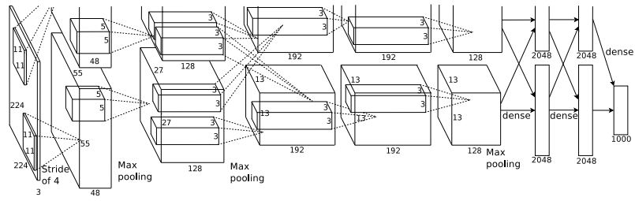
Convolutional Neural Networks
AlexNet
Alex Krizhevsky – 2012 (Krizhevsky Net)
Imagenet 2012 Challenge (1000 classes)
→ 1.2 M Train, 50K Val, 150K Test
2012 Winner (15.3% Error - Top 5)
→ 2° SIFT Based (26.2%)
Computer Vision - Prof. André Hochuli
Lecture 06
Notes:
Prof. André Hochuli

Slide 22
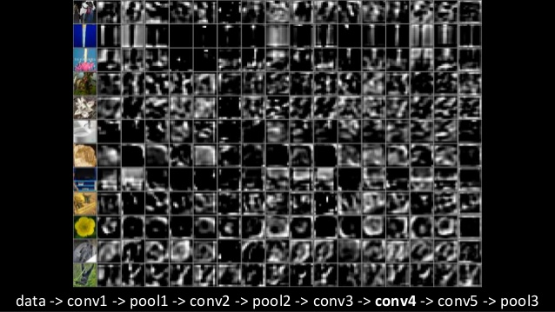
Convolutional Neural Networks
Alexnet
Computer Vision - Prof. André Hochuli
Lecture 06
Notes:
Prof. André Hochuli

Slide 23

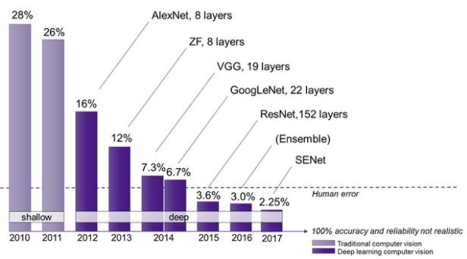
Imagenet Challenge
Imagenet Challenge (Classification)
1000 classes
1.2 M Train
50K Val
150K Test
Computer Vision - Prof. André Hochuli
Lecture 06
Notes:
Prof. André Hochuli

Slide 24
Let's Code
[LINK]
Computer Vision - Prof. André Hochuli
Lecture 06
Notes:
Prof. André Hochuli

